Slide 1

R.A.C.E.S. Spotter Safety
thumb
Spotting Preparation, Activation, Safety, and Communications
Notes:
Welcome to the R.A.C.E.S. Spotter Safety presentation.
Today, we're diving into the critical aspects of safety and efficiency for storm spotters in Sedgwick County.
Our focus will encompass a broad spectrum of topics essential for all R.A.C.E.S. members, from preparation and communication protocols to in-field safety and damage assessment.
This presentation is designed to reinforce our commitment to accurate reporting and safe practices while in the field.
We will explore how to effectively use tools like APRS for better spotter placement and safety, understand the importance of clear and concise communication, and discuss the best practices for navigating and observing storms safely.
Throughout this session, remember that the role of a spotter extends beyond mere observation; it's about ensuring public safety through diligent and precise reporting.
Our collective efforts contribute significantly to emergency response and community safety during severe weather events.
Let's embark on this journey of learning and reinforcing our skills to continue making a difference as skilled and safety-conscious members of the R.A.C.E.S. team

Slide 2
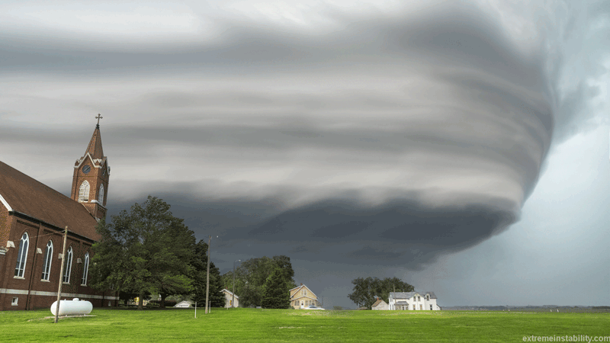
The Spotter's Mindset: Safety and Observation
You are a storm SPOTTER, not a storm chaser!
Your job is to provide factual, real-time information about weather conditions
We all work together in the
interest of public safety
To be an effective storm spotter
you must
also pay attention to your own
safety!
Notes:
We need to start by setting the tone for our role as storm spotters and underscores the mindset required for this crucial function.
It's imperative to recognize that as storm spotters, our purpose is distinctly different from that of storm chasers.
Our primary responsibility is to observe and report factual, real-time conditions to aid in public safety. This distinction is not just semantic; it's about priorities. Your reports can influence emergency response decisions and the safety of others.
Working together is at the heart of what we do. Collaboration ensures a wide network of observations, leading to a more accurate and comprehensive understanding of the weather threats facing our community.
An essential aspect of being an effective storm spotter is self-awareness and vigilance regarding your safety. The information you provide is valuable, but it should never come at the cost of your well-being.
As we proceed, remember that your safety enables you to continue the vital work of spotting. This presentation will equip you with the knowledge to keep yourself safe while you help keep others informed and protected.

Slide 3
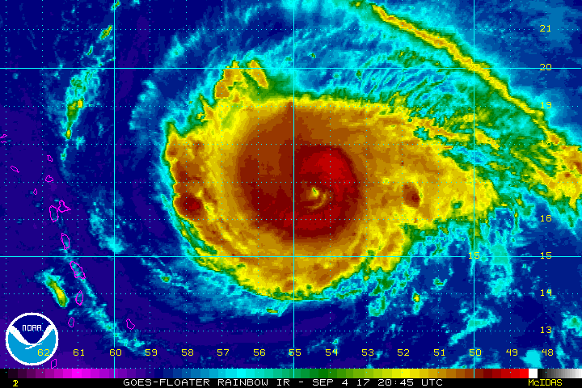
Seasonal Readiness for R.A.C.E.S. Spotters
Attend training sessions
  RACES Safety Training
  Emergency Management Training at the EOC
Stay alert to changing weather conditions
Vehicle, fueled and ready to go
Radio system tested and ready
To go and food kit checked and ready to go
Notes:
As we gear up for the storm spotting season, a comprehensive approach to preparation is crucial.
Engaging in RACES safety training hones our skills, ensuring we can effectively contribute to public safety.
Similarly, emergency management training at the EOC empowers us with the knowledge to coordinate seamlessly with other emergency responders.
Vigilance in monitoring weather conditions cannot be overstated. It equips us with the foresight needed to anticipate and react to weather events appropriately.
A storm spotter's readiness also hinges on their equipment and supplies. A well-maintained vehicle, complete with a full tank, is fundamental for mobility in response to unfolding weather events.
Just as critical is ensuring that the radio system is tested and functioning perfectly, as this is our primary tool for communication during operations.
Lastly, a checked and packed food kit is part of the essentials. It is not just about sustenance; it’s about maintaining a state of readiness, enabling us to focus on our duties without the distraction of basic needs during an emergency.

Slide 4
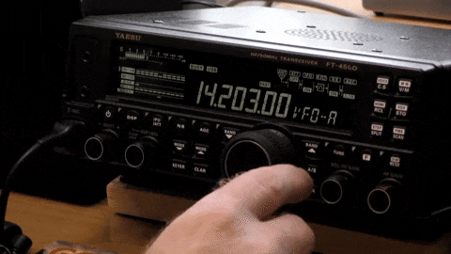
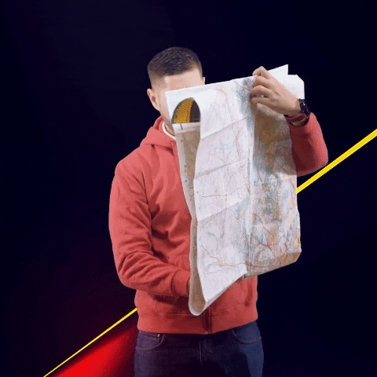
Essential Equipment for R.A.C.E.S. Spotters
    Radio or other communications equipment such as a HT
    Working APRS
    Clipboard, paper and pen
    Identification –RACES ID, drivers license, vehicle ID
    Report forms
    Wind gage, ruler, compass or GPS
    Flashlight with extra batteries and bulbs
    Binoculars
    Rain coat that is bright colored or worn with orange vest
    First Aid Kit
Notes:
Proper equipment is the backbone of effective storm spotting. Each item serves a purpose, whether it's for communication, navigation, or safety.
A reliable radio is your link to other spotters and the emergency network. APRS, or Automatic Packet Reporting System, tracks your location, providing real-time data that's invaluable during emergencies.
Always carry a clipboard, paper, and pen for notes and reports when technology fails. Your identification, including RACES ID, driver's license, and vehicle ID, should always be on hand to ensure access and verify your role as a spotter.
Use designated report forms like the RACES Emergency Weather Report and Windshield Assessment Survey to systematically capture critical data.
A map of Sedgwick County is essential for navigation and situational awareness.
Measurements and direction are crucial; thus, a wind gauge, ruler, compass, or GPS are necessary tools. A flashlight, with extra batteries and bulbs, ensures you can see and be seen in low visibility conditions.
Binoculars extend your range of sight, and a brightly colored raincoat or vest increases your visibility to others.
Lastly, a first aid kit is a must-have for personal safety, enabling you to address minor injuries immediately. Each piece of equipment is a critical component in your storm spotter toolkit.

Slide 5
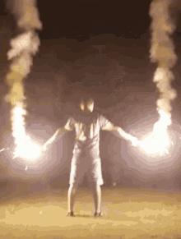
Supplementary Gear for Storm Spotters
    Gloves, Blanket
    Snacks, non-alcoholic drinks
    Video or digital camera
    Fire extinguisher
    Spare fuses, paper towels, insect repellant
    Additional pair of shoes
    Flares
Notes:
Equipping yourself with optional but highly recommended gear can significantly enhance comfort and readiness during extended periods of spotting.
Gloves and a blanket are simple additions that provide warmth in unexpectedly chilly conditions.
Staying hydrated and energized with snacks and non-alcoholic beverages is key, especially during long hours of observation.
For those who wish to document their findings more thoroughly, a video or digital camera can be invaluable. Not only do these tools help in recording the event for later analysis, but they also serve as a visual record to accompany your reports.
Safety should always be a priority, so consider carrying a fire extinguisher and spare fuses. These items can prevent small incidents from becoming emergencies.
Paper towels and insect repellent can offer additional comfort and utility in various outdoor conditions.
An extra pair of shoes ensures you can stay mobile even if one gets wet or damaged. Lastly, flares can be a critical safety tool, especially if you find yourself in need of assistance.
These supplementary items, while optional, can provide significant benefits to a storm spotter’s safety and effectiveness in the field

Slide 6
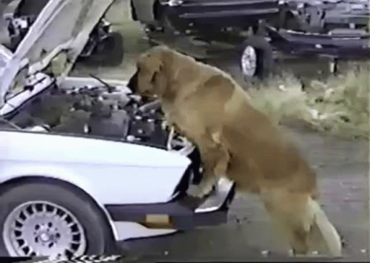
Routine Gear Inspection Checklist
    Inspect:
      Radios
      Coax
      Power connectors
      Antenna and antenna connector
      HT batteries - charged
Notes:
As we enter storm season, let's begin with a thorough inspection of our equipment. This ensures we can rely on our gear when it counts the most.
Start with the radios. Check each one for functionality, and make sure the settings are correct for our network frequencies.
Next, examine the coaxial cables. Look for any signs of wear or damage that could affect signal integrity.
Power connectors are often overlooked, yet they are vital. Ensure they are secure and free of corrosion to maintain consistent power supply to your equipment.
The antenna is your lifeline to the outside world during a storm. Inspect both the antenna and its connectors for any damage or loose parts that might impair performance.
Lastly, HT batteries should be fully charged. Consider doing a test run to see how long they hold their charge. It's better to identify a weak battery now than during critical field operations.
This routine inspection is not just a one-time task at the beginning of the season. Periodic checks will help avoid equipment failure and maintain operational readiness throughout the storm season.

Slide 7
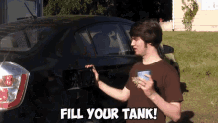
Spotter's Pre-Deployment Vehicle Checklist
    Fill the gas tank
    Make sure the lights all work:
      Headlights
      Flashers
      Turn signal
      Brake/backup
      Flashlights
    Check your tires – tread, pressure, and spare
    Check to make sure defroster is working
    Put a fresh coat of Rain-X on the windshield
    if you have time
    Check your fluid levels:
      Oil
      Coolant
      Brake
      Windshield
      cleaner
Notes:
Before we set out, let's run through the pre-deployment vehicle checklist. This is a critical step to ensure our safety and operational capability in the field.
Begin with the fuel. A full gas tank is essential – it could be a while before you're able to refuel.
Now, let’s move on to lighting. Check every light on your vehicle, including headlights, flashers, turn signals, and brake and backup lights. Visibility is crucial, not just for your ability to see, but also to be seen by others.
Don’t forget flashlights. Ensure they’re working and that you have extra batteries.
Inspect your tires thoroughly. Look at the tread depth, check the pressure, and confirm you have a fully functional spare.
Defrosters are often underappreciated until you need them. Verify yours is working to keep your windshield clear.
If possible, apply a fresh coat of Rain-X on the windshield. This will improve visibility during heavy rain.
Lastly, top off all your fluid levels. This includes oil, coolant, brake fluid, and windshield cleaner. These might seem like small details, but they can significantly impact your safety and effectiveness as a spotter.
Following this checklist before deployment can prevent many common issues that might otherwise hinder our mission.

Slide 8
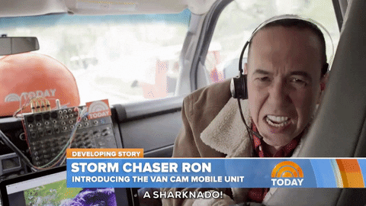
Spotter Activation
Level 1 Activation
  Emergency Management / Races Officer will send a page out of possible activation (others listen closely to the radio 146.94)
  Once the page or radio alert is received start preparation for possible activation
Level 2 Activation
  Net Control will activate and announce the Severe Weather Net, Listen for instructions
  Net Control will take check-ins , we will need your call sign and current location.
  Net Control will contact EOC Officer at EOC
  Net Control will assign location to the spotters.
  Once spotter has arrived at their location the spotter will check back in
Notes:
Welcome to the critical phase of our storm spotting protocol – Spotter Activation. In this phase, our responsiveness and attention to detail are paramount.
During a Level 1 Activation, you will be alerted via page or radio to potential severe weather conditions. This is your cue to start preparations for deployment, ensuring your equipment is in check and you're ready to move at a moment's notice.
A Net Control Station (NCS) is an operator responsible for controlling all radio traffic on the repeater during a directed net.
With a Level 2 Activation, the stakes are higher as the Severe Weather Net goes live. It is crucial that you tune in attentively for instructions from Net Control.
When checking in, remember to provide your call sign and location promptly. Coordination is key; Net Control will liaise with the Emergency Operations Center Officer and assign locations to each spotter.
Upon reaching your designated location, it's imperative to report back to Net Control.
This structured communication ensures we maintain a cohesive network, ready to serve and protect our community in the face of severe weather.
Remember, your safety is as important as your service. Keep these protocols in mind and stay vigilant for the call to action.

Slide 9
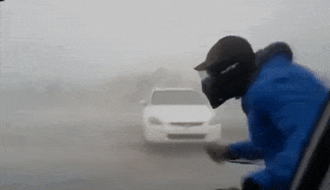
Field Activation Protocols
Spotters find an area with as good a view as possible.
Net Control will periodically ask for updates as to what you see
If the weather event fits the criteria please report it immediately to Net Control
If life or property is at risk break in to Net Control with the emergency
Once the watch/warning is over and you are not needed Net Control will send you home.
Once arrived at your home please notify Net Control.
Once all is clear Net Control will shut down the RACES Severe Weather Net
Notes:
As spotters, your primary goal is to find a location that gives you the widest and clearest view of the sky. Your real-time observations are invaluable, and staying in consistent contact with Net Control is essential.
If you witness a weather event that matches our criteria for severity, don't hesitate to report it to Net Control immediately. Remember, your updates can be critical in a severe weather situation.
Should you encounter any emergency that poses immediate danger to life or property, it's imperative to break into the Net Control frequency and report the emergency. Your alertness can save lives.
After the storm watch or warning has passed and Net Control has confirmed that your services are no longer required, you'll be directed to return home. It's important to then check in with Net Control once you've reached home safely, so we can account for all our spotters.
If for any reason you need to change your location during the activation, please inform Net Control. It's crucial that we maintain an accurate log of your whereabouts for your safety and effective coordination.
Throughout your activation, I can't stress enough the importance of clear and calm communication. It’s not just what you say but also how you say it that can influence the stress levels and responses of others.
Lastly, be prepared for the possibility of being moved by Net Control to different locations as the situation evolves. Flexibility and adaptability are key traits of an effective spotter. Your safety and the safety of the community are our top priorities.

Slide 10

Precision in Reporting: The Cornerstone of Spotter Credibility
Your job is to observe and communicate
CREDIBILITY is key!
Be objective in your reporting
Notes:
In our role as spotters, the essence of what we do lies in two fundamental actions: observing and communicating. The heart of effective communication is credibility. Every report you give is a building block in the trust that our community places in us, so it's essential that each report you make is grounded in objectivity.
When you're reporting, focus on the facts. Describe what you see in clear, concise terms. Your observations should be devoid of personal interpretation or emotion. A calm demeanor in your voice can not only convey professionalism but also prevent unnecessary panic and ensure the clarity of your message.
Remember to only report direct observations and experiences. If you’re describing something that isn’t easily quantifiable, try to provide a reference that can be understood universally. For instance, instead of saying 'large hail,' you could say 'hail the size of a quarter.’
Every detail counts. When you're reporting on weather events, be specific about the location, direction, and any movement observed. Saying 'tornado moving northeast, crossing Highway 50' provides a clear, actionable piece of information that our emergency management can use.
In summary, the way we communicate can be just as impactful as the information itself. Let's ensure our reports are as reliable and professional as the service we aim to provide.

Slide 11
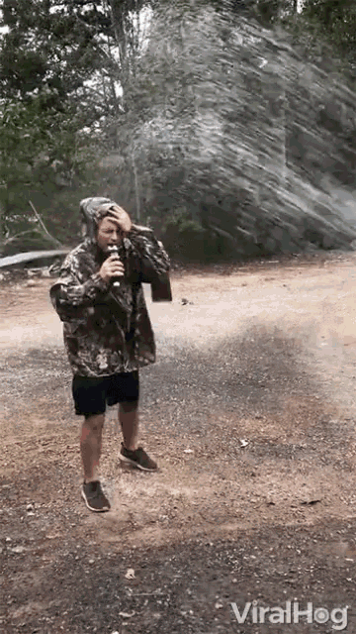
Communications (cont.)
Give all reports with respect to your location
Estimate wind speeds or describe damage being caused
“When in doubt, don’t shout.”
Report roads blocked by traffic (i.e. Chasers)
A thunderstorm is classified as severe if one or more of
the following are observed:
  Tornado or funnel cloud
  Winds 58 mph or greater
  Hail 1 inch or greater in diameter (Quarter)
Notes:
In our pivotal role as spotters for R.A.C.E.S., every report we make is a critical input for safety assessments and emergency response.
It's vital to anchor each of your reports to your specific location. This not only provides context but also helps emergency services pinpoint areas of concern accurately.
When reporting wind speeds, use estimates based on observed effects, such as branches breaking or structural damage, rather than guesses. Remember the adage, 'When in doubt, don’t shout.' This means if you’re uncertain about what you’re witnessing, take the necessary time to observe and understand before communicating your report. Premature or inaccurate reports can lead to confusion and misallocation of resources.
Also, it’s important to communicate any obstructions like roads blocked by traffic or storm chasers. This information is crucial for maintaining clear paths for emergency vehicles and other responders.
Be aware of the criteria that classify a thunderstorm as severe: the presence of a tornado or funnel cloud, winds reaching 58 mph or greater, or hail at least 1 inch in diameter, which is roughly the size of a quarter.
In every instance, report precisely what you see. Speculation or assumption can lead to misinformation. If you’re not sure of what you're observing, wait, watch, and then report. Your due diligence ensures that our communications remain a reliable resource for our community’s safety.

Slide 12
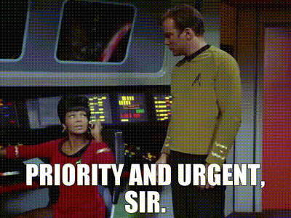
Observations - URGENT Priority
Wall Clouds
Rotating wall cloud
Funnel cloud
Funnel Clouds with rotation
Tornado
Flash flooding
Notes:
As spotters, your observations are the first line of defense for the community. Immediate and clear communication is crucial when you spot severe weather phenomena.
When reporting, prioritize sightings of wall clouds, especially those showing rotation, as they can be precursors to tornadoes.
If you observe funnel clouds, note whether there is rotation, as this detail is critical.
Directly report any tornadoes, ensuring that you provide precise location details to assist emergency management in issuing timely warnings.
Similarly, flash flooding should be reported without delay to prevent harm, as water levels can rise rapidly and become dangerous.
Your reports on these conditions can significantly impact the safety measures taken by the emergency services

Slide 13

Observations - HIGH Priority
Winds speeds greater than 58 mph (or damaging winds, damage to chimneys and TV antennas, shallow rooted trees pushed over)
Persistent non-rotating wall cloud
Hail 1 inch or greater in diameter
Rainfall 1 inch or more per hour, Flooding
Notes:
In your role as spotters, your vigilance and timely reporting of high-priority weather conditions are vital.
When wind speeds exceed 58 mph, or you witness damaging winds causing structural damage or uprooting trees, it's crucial to report immediately.
If you spot a persistent, non-rotating wall cloud, this too warrants a high-priority report due to the potential for severe weather development.
Significant hail events, specifically when hailstones reach or surpass 1 inch in diameter, can cause substantial damage and must be communicated quickly.
Lastly, intense rainfall that leads to an inch or more per hour and any resultant flooding is a high-priority communication.
These conditions can escalate rapidly, and your reports are integral to the community's safety and preparedness

Slide 14

Observations - Priority Information
Information on what you are observing
  Based on the prior criteria
Give your location and the direction you are looking.
Give direction of movement and estimated speed
Damage you have observed
  Lightning strikes that started fires=
  Traffic lights not working
  Building or road damage
  Damaged or broken gas or power lines
  Injured persons or vehicle accidents
Notes:
In our role as spotters, the precision and clarity of our observations can make the difference in emergency response.
It's crucial to report only verifiable facts, including your exact location and the specific direction you're observing from.
Note the direction and estimated speed of the storm. If you see damage, describe it succinctly — whether it's structural damage, downed power lines, or any other hazards.
This information is vital for the safety of the public and the efficiency of our emergency services. Remember, your reports are a valuable asset to the community during severe weather conditions.

Slide 15

Communications Protocol: Effective Net Traffic Interruption
Use break tags if necessary to break into existing net traffic
  BREAK – used to report important but non-life threatening info (such as damage)
  BREAK BREAK BREAK – used only for life or property threatening or damaging incident
Notes:
Clear and effective communication is the cornerstone of successful spotting. It's imperative to understand and use break tags when needed to convey critical information.
A single 'BREAK' is your signal to report significant, yet non-emergent events, such as property damage.
The use of 'BREAK BREAK BREAK' is reserved exclusively for urgent situations where there's an immediate threat to life or significant property damage.
This protocol helps prioritize transmissions and ensures that the most critical information is communicated without delay

Slide 16
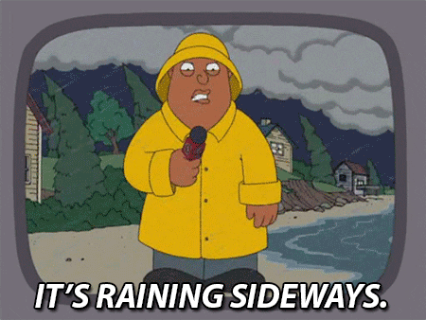
Unnecessary Communications: What Not to Report
“I have light rain at my location”
“I can see lightning off in the distance!”
“It’s starting to brighten up here.”
“The clouds are really dark to the west.”
Notes:
As vital as clear and precise communication is to our operations, it's equally important to recognize what constitutes unnecessary reports.
Cluttering the airwaves with observations that don't provide actionable data can hinder our efficiency.
For example, reports of light rain, distant lightning, changing light conditions, or subjective descriptions of cloud color do not offer the detailed, significant information required for a coordinated response.
Keeping our communications concise and relevant ensures that critical reports are heard and addressed promptly.

Slide 17
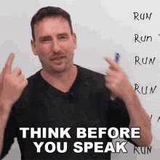
Effective Communication Protocols for Spotters
  Keep your radio traffic:
    Calm
    Brief
    Concise
    Accurate
  Think about what you are going to say before you say it!
  Frequencies used if activated
    Primary - 146.94
    Simplex - 146.94
    Backup 70cm - 444.000 (analog)
    Backup D-Star - 442.600
    Backup 2m - 147.105(+)
Notes:
In the field, our communication is the lifeline of operations, so it's crucial to maintain a standard. When we communicate, we aim for calm, brief, concise, and accurate transmissions.
Before you press the talk button, take a moment to think about your message—ensure it's necessary and adds value.
Remember, we're not just chatting about the weather; we're providing crucial updates that can affect lives and property.
Therefore, avoid reporting common conditions like light rain or subjective observations like the darkness of clouds. Instead, focus on significant changes or events.
Our primary frequency is 146.94, with additional simplex and backup frequencies available to ensure we stay connected regardless of conditions.
Keep these frequencies handy, and always prioritize the clarity and usefulness of your reports.

Slide 18

Teamwork in the Field: Driver and Spotter Roles Safety
Take a partner if possible
Driver concentrates on the road
Spotter concentrates on spotting and navigating
Always let net control know where you are
Notes:
Safety is paramount in spotting operations, and one key aspect is the collaboration between the driver and the spotter.
If possible, always work in pairs. This allows the driver to focus solely on the road, navigating safely under potentially hazardous conditions.
Meanwhile, the spotter can dedicate their attention to observing weather patterns and communicating findings.
This division of responsibilities ensures a higher level of safety and efficiency.
No matter where your mission takes you, keeping net control updated on your location is critical. It ensures that, should an emergency arise, support knows exactly where to find you.
Remember, your safety enables you to keep others safe.

Slide 19
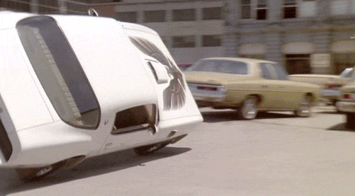
Strategic Positioning for Effective Spotting
Move completely out of traffic
Be visible - parking lights (not hazard flashers) or yellow caution light
Be sure you have a good field of view (at least 180⁰)
  Important for spotting and safety
Check Your environment
A storm spotter plans an escape route
when stopped or driving to observing
a storm.
Notes:
Selecting the right location to carry out spotting is a critical step. Ensure that you are completely out of the way of traffic to maintain safety for yourself and others.
Use your parking lights to remain visible to passersby without the potential confusion caused by hazard flashers.
An optimal field of view is essential, not just for weather observation but also for maintaining situational awareness of your surroundings.
Evaluate your immediate environment for potential hazards. Look out for power lines, areas with excessive mud, or tall, dry grass that could pose a fire risk.
It’s also wise to steer clear of low-lying areas where water can accumulate rapidly or places where debris could become airborne during strong winds.
Always have an exit strategy. Position your vehicle so you can leave quickly if necessary, and consider the wind direction when parking.
Your priority is to keep a step ahead of the weather while ensuring your personal safety and the safety of your team.

Slide 20
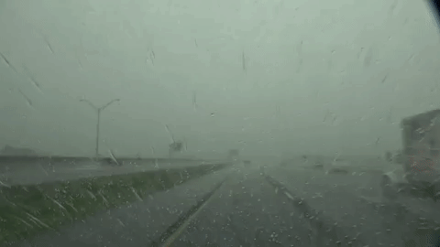
Driving Navigating Through Storms: Spotter Road Safety
Rural intersections can have low visibility due to crops or weather
Heavy rain and hail = poor visibility and may mean you are in “wrong” part of storm!
Avoid water flowing over roads
Notes:
As spotters, while our primary focus is on the skies, we cannot overlook the importance of road safety.
When driving in rural areas, especially during a storm, be extra cautious at intersections where visibility can be severely reduced by crops at the roadside or the intensity of the weather itself.
During heavy rain and hail, visibility can diminish quickly, which not only makes driving hazardous but also signals that you might be in the most volatile part of the storm.
It's crucial to recognize the dangers of water on the road. As little as six inches of moving water can cause a vehicle to hydroplane and potentially lose control.
Remember the rule of thumb for water on the road: if the lines are obscured and you can't gauge the depth of the water, it's best to turn around and find an alternative route.
Your safety is paramount; no observation is worth compromising that

Slide 21
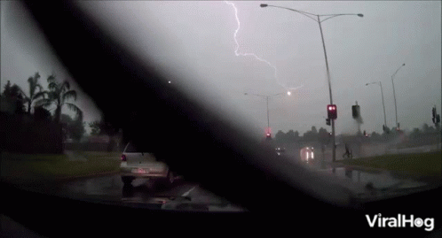
Electrical Storm Protocol: Ensuring Spotter Safety Against Lightning
Lightning can strike miles away stay in your vehicle
Avoid being the highest object and avoid being near the highest object.
Don’t park under power lines or trees in a lightning storm.
Keep your car doors and windows closed
and avoid hanging your arm out the window.
In a lightning storm avoid holding the radio
microphone. Hang it up!
Notes:
As storm spotters, we're often in the thick of the weather, and that means dealing with lightning, a fascinating yet dangerous element of any storm.
It's essential to remember that lightning can strike unpredictably and can reach out as far as miles away from the storm center.
The safest place during a lightning storm is inside your vehicle, a concept known as the Faraday cage effect, where the electric charge stays on the exterior of a conducting body.
It's also crucial to avoid being the tallest object in an area or parking near one, such as trees or power lines, which are prime targets for lightning strikes.
When you're inside the car, keep the doors and windows closed to maintain the protective barrier of the vehicle. This also means avoiding actions like resting your arm out of the window which can put you at risk.
Lastly, remember to keep your radio communications equipment, particularly the microphone, at a distance.
Hang it up instead of holding it during a storm, as metal objects can attract lightning.
Your role as a spotter is vital, but it should never come at the expense of your safety

Slide 22
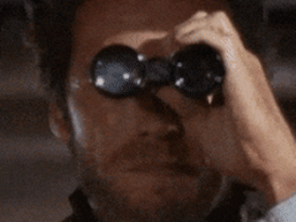
Best Practices for Storm Observation
When stopped to view a storm:
  Be extra cautious at night
  Don’t trespass on private property.
  Don’t lay your mic on the seat
  Hang it up.
  Keep your engine running
  when you park your vehicle to
  view a potentially dangerous
  storm
  Be familiar with the area from
  which you will be observing
Notes:
Observing a storm requires not only keen attention to weather patterns but also adherence to safety and respectful practices.
Nighttime observations demand heightened caution. Limited visibility can mask hazards, making it essential to be even more vigilant about your surroundings.
Respect for private property is fundamental. Always ensure that you are on public land or have permission if you find yourself on private property.
Trespassing not only damages our reputation as responsible spotters but also puts you at legal risk.
Regarding your equipment, specifically the radio microphone, it's important to keep it hung up rather than laying it on the seat.
It is a good reason to have APRS so your support group knows exactly where you are.
This prevents any accidental transmission and keeps the equipment readily accessible and in good order. Each of these practices plays a part in ensuring that our storm observation is both safe and respectful.

Slide 23
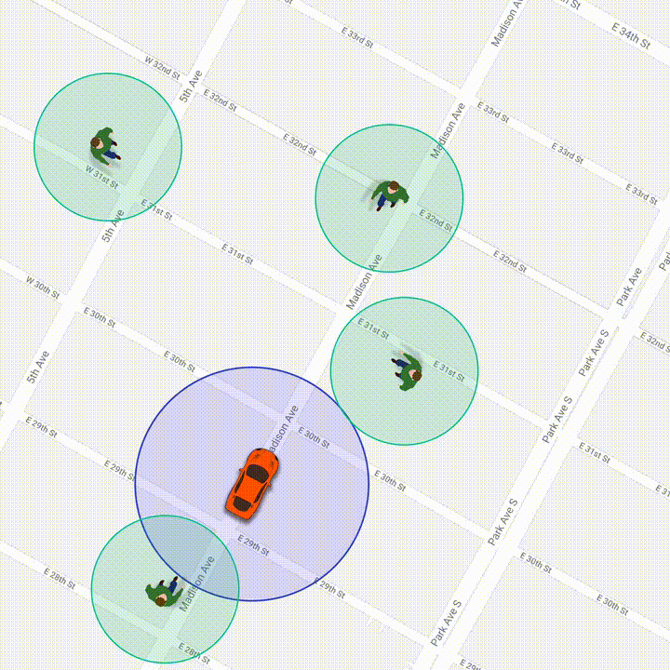
Utilizing APRS in Spotter Operations
We use APRS
  To maximize results by better placement of spotters
  To position spotters out of harms way
  If contact is lost, last position is known
  If help is needed, GPS coordinates are known
Notes:
APRS is often incorrectly said to stand for Automatic Position Reporting System. It is actually, Automatic Packet Reporting System
APRS is becoming steadily more popular due to the falling cost of GPS hardware and the advent of commercial transceivers from Kenwood and Yaesu with built-in APRS support.
The use of APRS in our operations enhances the efficiency and safety of our spotting activities. By employing APRS, we can strategically position our spotters for maximum observation effectiveness.
This system enables us to place spotters in locations where they can provide the most valuable information without compromising their safety.
Another key advantage of APRS is its role in maintaining communication and safety. If we lose contact with a spotter, APRS provides us with their last known position, which is crucial for ensuring their safety.
In emergency situations where a spotter might need assistance, having accurate GPS coordinates readily available can expedite rescue and support efforts.
In summary, APRS is not just a tool for communication; it's an integral part of our safety protocol, ensuring that each member of our team can perform their duties effectively while maintaining the highest safety standards.

Slide 24
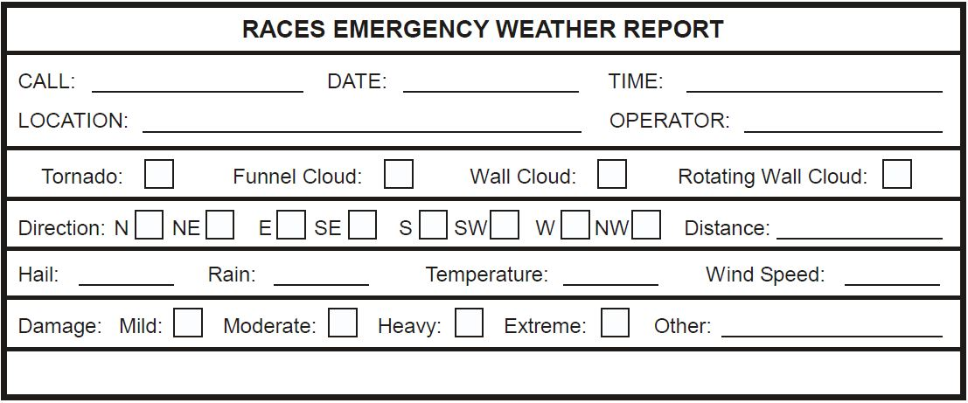
Emergency Weather Report Example

Slide 25
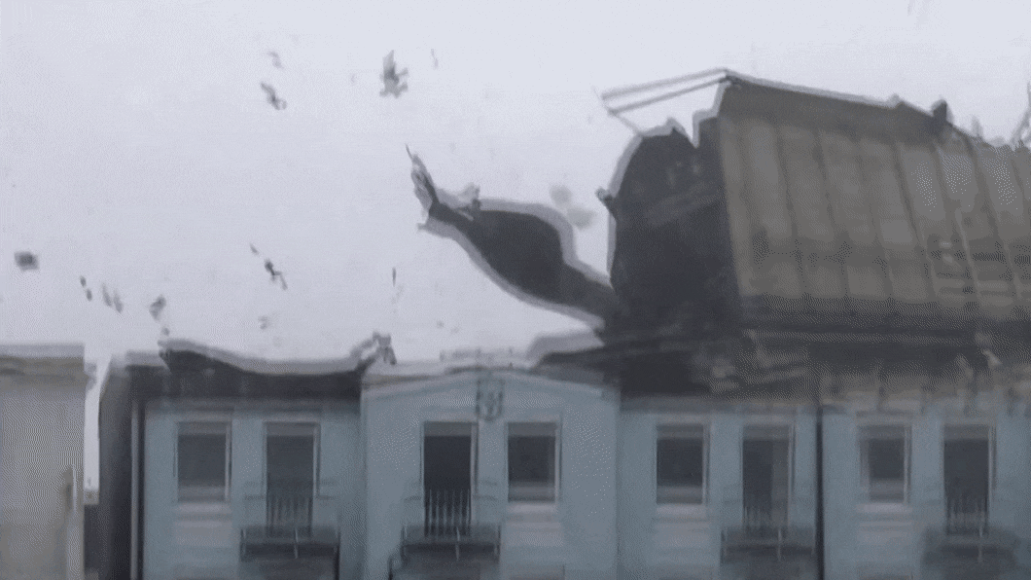
Damage Assessment
As a spotter you are first on the scene and the first to assess the damage. This assessment will allow emergency management to respond quickly and efficiently.
Reporting Damage Information:
  Location
  Width and Length
  Category or Amount of Damage
Notes:
Damage Assessment is the process for determining the nature and extent of the loss, suffering, and/or harm to the community resulting from a disaster.
Damage assessment provides situational awareness and critical information on:
Type, scope and severity of the event
Impact on individuals and communities
Additional resource needs
Justification for disaster declaration
Emergency public information
Future hazard mitigation projects

Slide 26
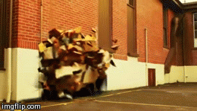
Classifying Storm Damage: Spotter Assessment Guidelines
Assessment falls into 4 categories:
Affected
Minor
Major
Destroyed
Notes:
When assessing storm damage, it's important to categorize the level of impact accurately.
This helps in communicating the severity of the situation to emergency management and other relevant authorities.
Damage is classified into four categories: 'Affected,' 'Minor,' 'Major,' and 'Destroyed.’
'Affected' refers to structures that have endured the storm without sustaining structural damage. These buildings are habitable and do not require immediate repairs.
'Minor' damage indicates that a structure is uninhabitable at present but can be restored to a habitable state with repairs completed in less than 30 days.
'Major' damage classification is used when a structure is uninhabitable and needs extensive repairs that will extend beyond 30 days.
Lastly, 'Destroyed' is used to describe a total loss, where a structure is permanently uninhabitable and beyond repair.
Understanding and using these categories helps provide clear, concise, and uniform reports, aiding in the efficient allocation of resources and assistance in the aftermath of a storm.

Slide 27
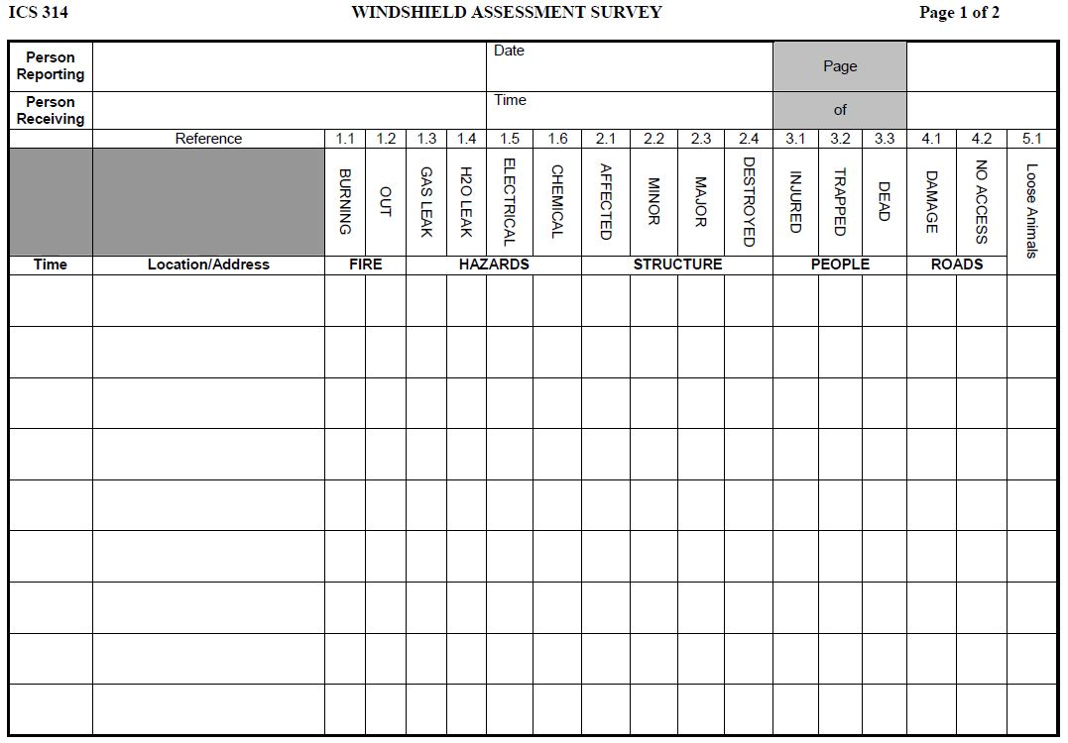
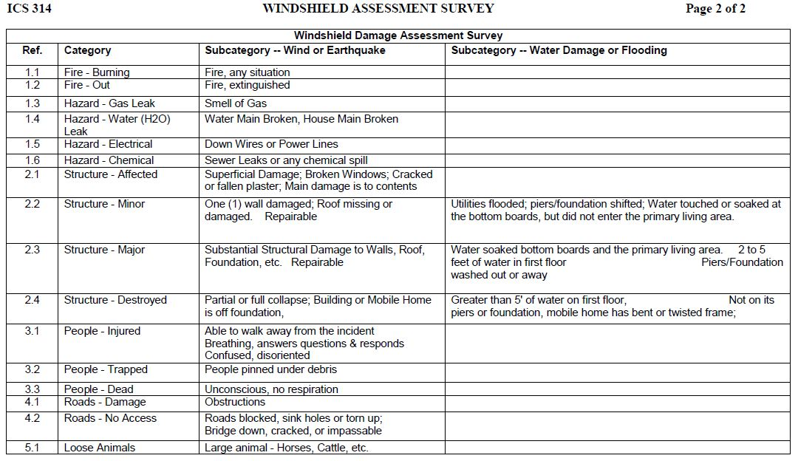
Damage Assessment Form Example
Notes:
Review form, hand out copies

Slide 28
Questions?

